Slide 1
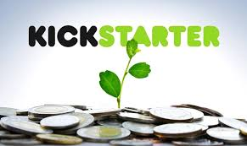

CROWDFUNDING KICKSTARTER
Mentor: Dhanshree Mam
Silvan Wilson Fernandes.
GROUP – 01
Ramya Sree.
Lava Ankagalla.
Rohan Hajare.
Madhuri Deshmukh.
Sasi Varagani.

Slide 2

CONTENT OF CROWDFUNDING
Introduction.
Objectives of crowdfunding, data overview
Project Report Using-
Excel Visualization
Power BI Visualization
Tableau Visualization
Outcomes of crowdfunding analysis
Recommendation, suggestion
Marketing Strategies

Slide 3
WHAT IS CROWDFUNDING ?
Crowdfunding is the practice of funding a project or venture by raising small amounts of money from a large number of people, typically via the Internet.
Crowdfunding is a form of crowdsourcing and alternative finance. In 2015, over US$34 billion was raised worldwide by crowdfunding .

Slide 4
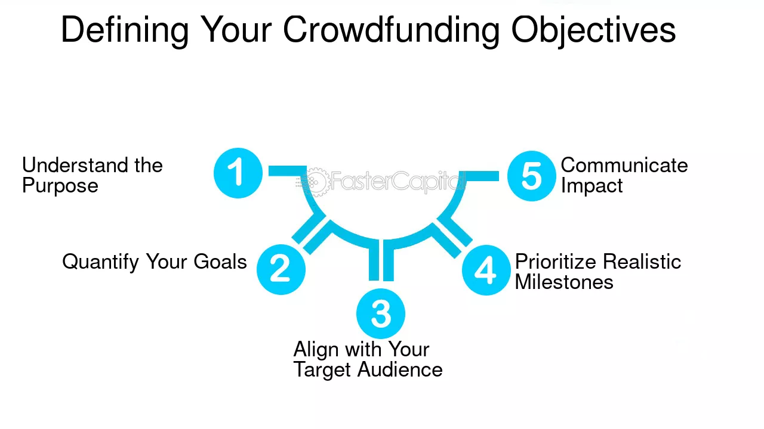
Objectives of Crowdfunding

Slide 5
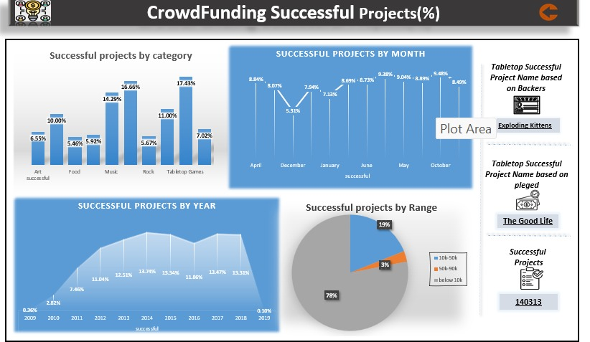
Using Excel Tool Visualization
Project Report -

Slide 6
The Excel Dashboard provides insights into the success of Kickstarter campaigns across various dimensions:
- Categories with the highest success rates include Tabletop Games and Rock music.
- Projects funded below $10K had the highest success rate at 78%.
- Success trends show steady growth from 2010 to 2018.
- Certain months like April and October witnessed higher project success rates.
- Top-performing projects include 'Exploding Kittens' (by backers) and 'The Good Life' (by funds raised).

Slide 7
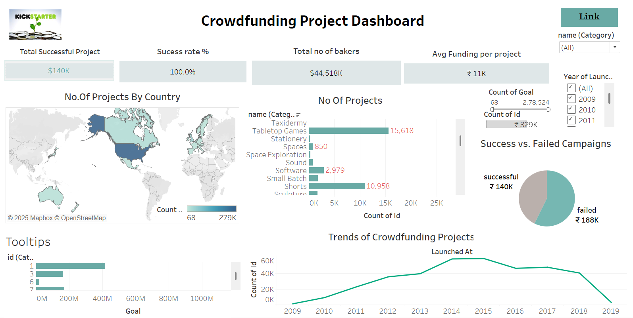
Using Tableau Tool Visualization
Project Report -

Slide 8
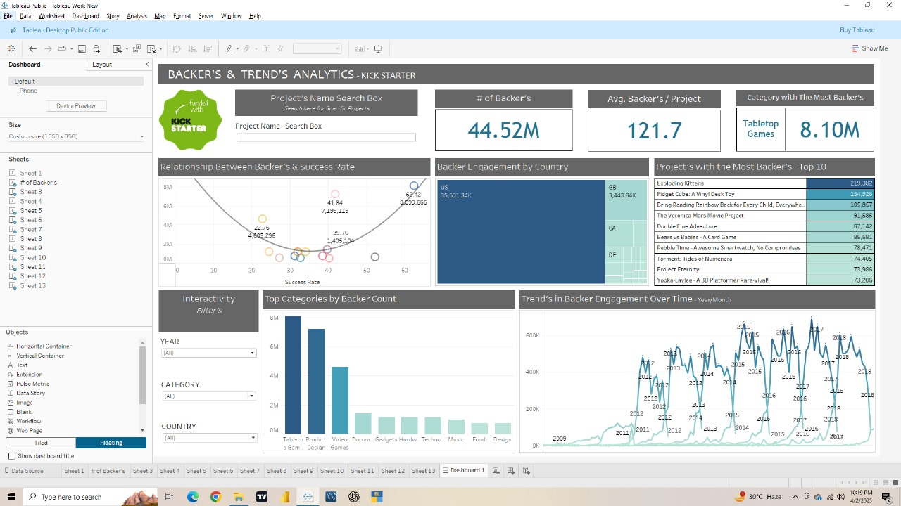
Backer’s & Trends Analytics - Tableau

Slide 9
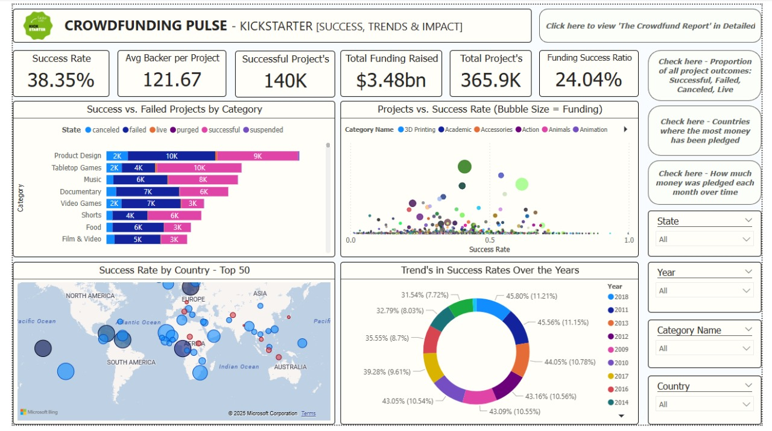
Using Power BI Tool Visualization
Project Report -

Slide 10
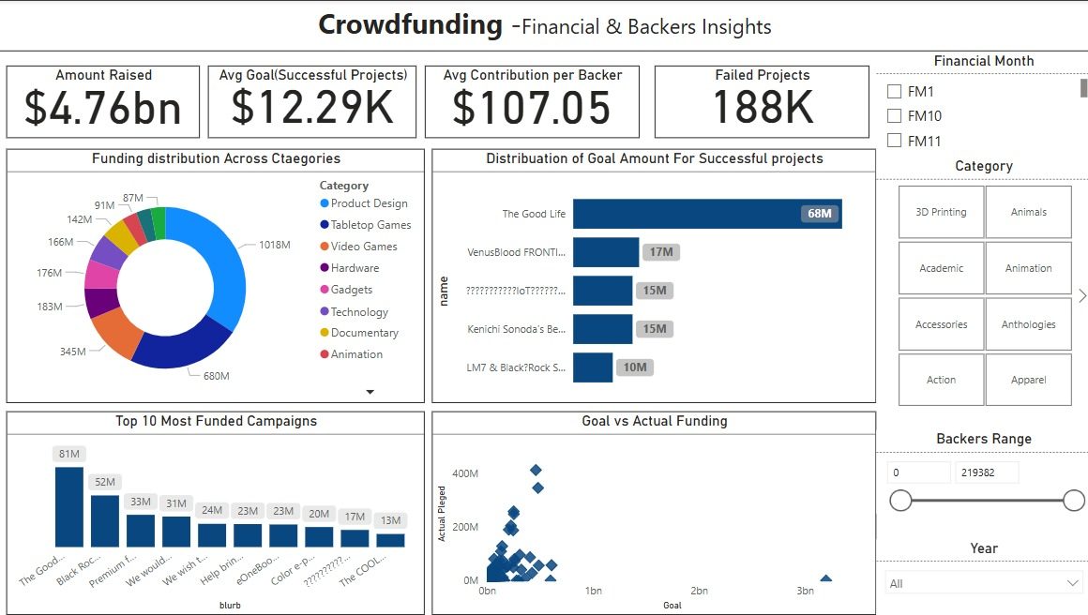
Dashboard - Financial & Bakers Insights

Slide 11
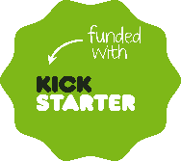
Outcomes of Crowdfunding
Enabled launch of innovative projects across Technology, Art, and Design.
Reduced reliance on traditional investors.
Built trust via direct engagement with backers.
Demonstrated power of social proof in campaign success.
Extended global visibility for independent creators.

Slide 12
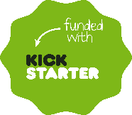
Recommendations
Use storytelling, visuals, and videos to boost credibility.
Set achievable goals with transparent budget details.
Offer attractive, tiered rewards to engage backers.
Maintain regular updates to foster backer trust.
Leverage analytics to optimize campaign performance.

Slide 13
Marketing Strategies
Utilize social media platforms for campaign promotion.
Collaborate with influencers to expand reach.
Launch email campaigns before project goes live.
Provide early-bird offers for initial backers.
Engage in relevant online communities and forums.

Slide 14
Insights & Learnings (Team Reflection)
Hands-on experience with Excel, Power BI, and Tableau.
Analyzed patterns in successful vs. failed campaigns.
Learned how to match tools to types of data analysis.
Improved teamwork and communication during project.

Slide 15
Conclusion & Future Scope
Crowdfunding is evolving with AI and blockchain innovations.
Predictive analytics will support better campaign planning.
Creators will rely more on data to engage and retain backers.
Our project shows the power of data in transforming ideas into reality.

Slide 16
THANK YOU

